Slide 1
Tukey HSD Multiple Comparison Test
Example: Differences is stopping distance by brand of tire

Slide 2
Goal:
The goal of Tukey’s HSD is either to identify pairs of treatments that ARE significantly different or pairs of treatments that ARE NOT significantly different when faced with a list of multiple treatments.

Slide 3
Example:
Let’s say that all tire stores only carry two brands of tire. You need to get new tires, but are in a rush. You only have time to visit one store. You carry about safety over cost; you will always pick the tire with the shortest stopping distance regardless of how much more it costs. However, you do not want to pay more for a tire that is not safer; if there is no significant difference in stopping distance between two tires you will choose the cheaper option.
What do you do?

Slide 4
Data:
Treatment = Brand
Response = Stopping Distance (a measure of safety)
Brand: Stopping Distances for 4 tires:
S1 22 20 25 17
S2 26 22 27 21
B1 16 20 14 18
B2 20 25 26 21
R1 28 29 23 24
R2 22 15 19 16

Slide 5

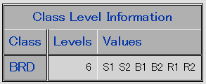
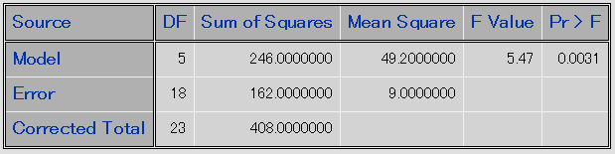
AOV Table:
Order treatments read in:
AOV Table:
Significant evidence of at least one difference in the t=6 treatment means

Slide 6

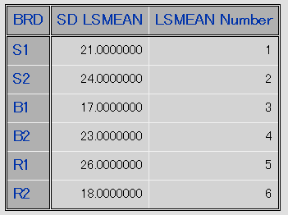
Tukey HSD Multiple Comparison Test:
Raw treatment means:

Slide 7
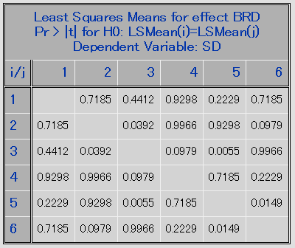
Tukey HSD Multiple Comparison Test:
Tukey Adjusted p-values for testing H0: Mu_i = Mu_k:
S1 S2 B1 B2 R1 R2
S1
S2
B1
B2
R1
R2
Note: these are not raw p-values. They are Tukey Adjusted P-values.
What we want to do with these is group them in groups of all trt’s that are not significantly different from eachother.
The easiest way to do this is to order them from smallest mean to largest mean:
Smallest
B1 | R2 | S1 | B2 | S2 | R1
17 | 18 | 21 | 23 | 24 | 26
Largest

Slide 8
Tukey HSD Multiple Comparison Test:
Once we have our means ordered, we’re doing pairwise comparisons.
Start with the smallest one and compare to all the rest by p-values.
Connect with a line when P-values not significantly different.
B1 | R2 | S1 | B2 | S2 | R1
17 | 18 | 21 | 23 | 24 | 26
Compare B1 to R2: p>0.05: Same. Connect.
Compare B1 to S1: p>0.05: Same. Connect.
Compare B1 to B2: p>0.05: Same. Connect.
Compare B1 to S2: p<0.05: Different. Don’t connect.
-> B1, R2, S1, B2 do not have significantly different means.
Compare R2 to S1: p>0.05: Same. Connect.
Compare R2 to B2: p>0.05: Same. Connect.
Compare R2 to S2: p<0.05: Same. Connect.
Compare R2 to R1: p<0.05: Different. Don’t connect.
-> R2, S1, B2, S2 do not have significantly different means.
-> B2, S2, R1all have p-values>0.05 when compared with S1; all one group.

Slide 9
Tukey HSD Multiple Comparison Test:
The goal of Tukey’s HSD is either to identify pairs that ARE significantly Different or pairs that ARE NOT significantly different.
Pairs that ARE NOT significantly Different
As a pair, any two treatments that appear in a group together are not significantly different.
Group 1: {B1, R2, S1, B2}
Group 2: {R2, S1, B2, S2}
Group 3: {S1, B2, S2, R1}
R2 is in group A and S2 is not.
S2 is in group C and R2 is not.
But they both appear in group B, so they are not significantly different.
Pairs that ARE significantly different:
B1 and S2 never appear in a group together. The are significantly different.
B1 and R1 never appear in a group together. The are significantly different.
R2 and R1 never appear in a group together. The are significantly different.

Slide 10
Conclusion:
Let’s say that all tire stores only carry two brands of tire. You need to get new tires, but are in a rush. You only have time to visit one store. You carry about safety over cost; you will always pick the tire with the shortest stopping distance regardless of how much more it costs. However, you do not want to pay more for a tire that is not safer; if there is no significant difference in stopping distance between two tires you will choose the cheaper option.
What do you do?
If the store you visit stocks brands B1 and S2, then purchase B1. It is safer.
If the store you visit stocks brands B1 and R1, then purchase B1. It is safer.
If the store you visit stocks brands R2 and R1, then purchase R2. It is safer.
If the store you visit stocks any other pair of brands, then purchase the cheaper option. There is no difference in safety between any other set of pairs.

